Slide 1
Wireless Tape Measurer
Veronika Sermeno Pon
TECHIN 514
Final Project
Github Repo: https://github.com/vpon-lab/514-Final-Project

Slide 2
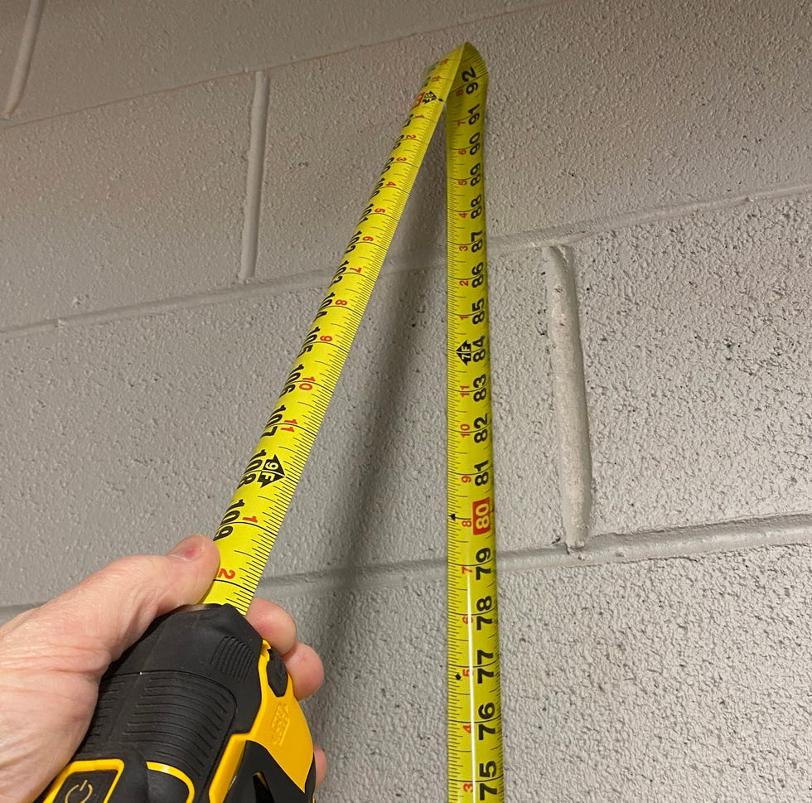
Measuring alone
Problem to Solve:
Wanting to measure bedroom space on your own with out another person’s assistance.
Mitigate sag from a physical tape measurer.

Slide 3
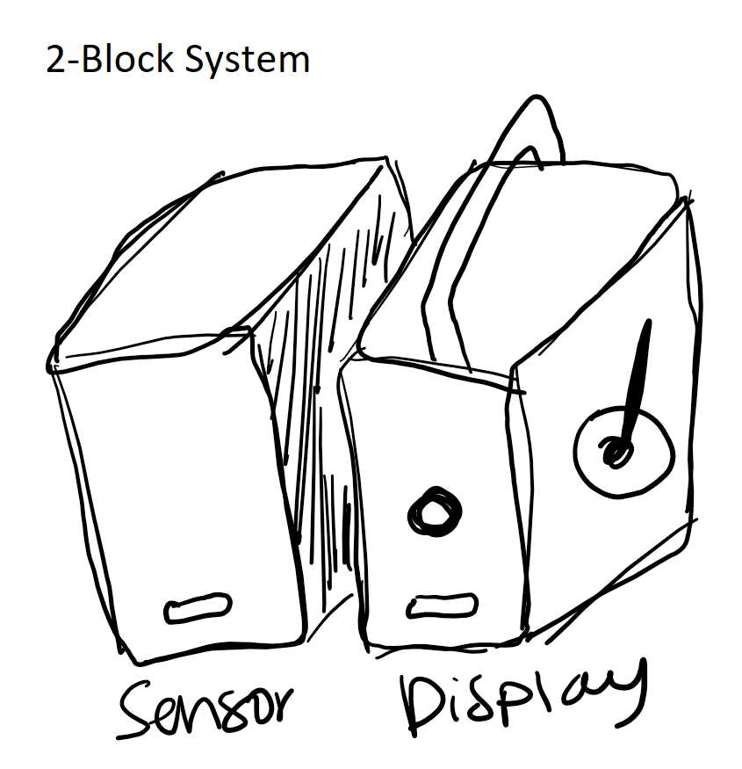
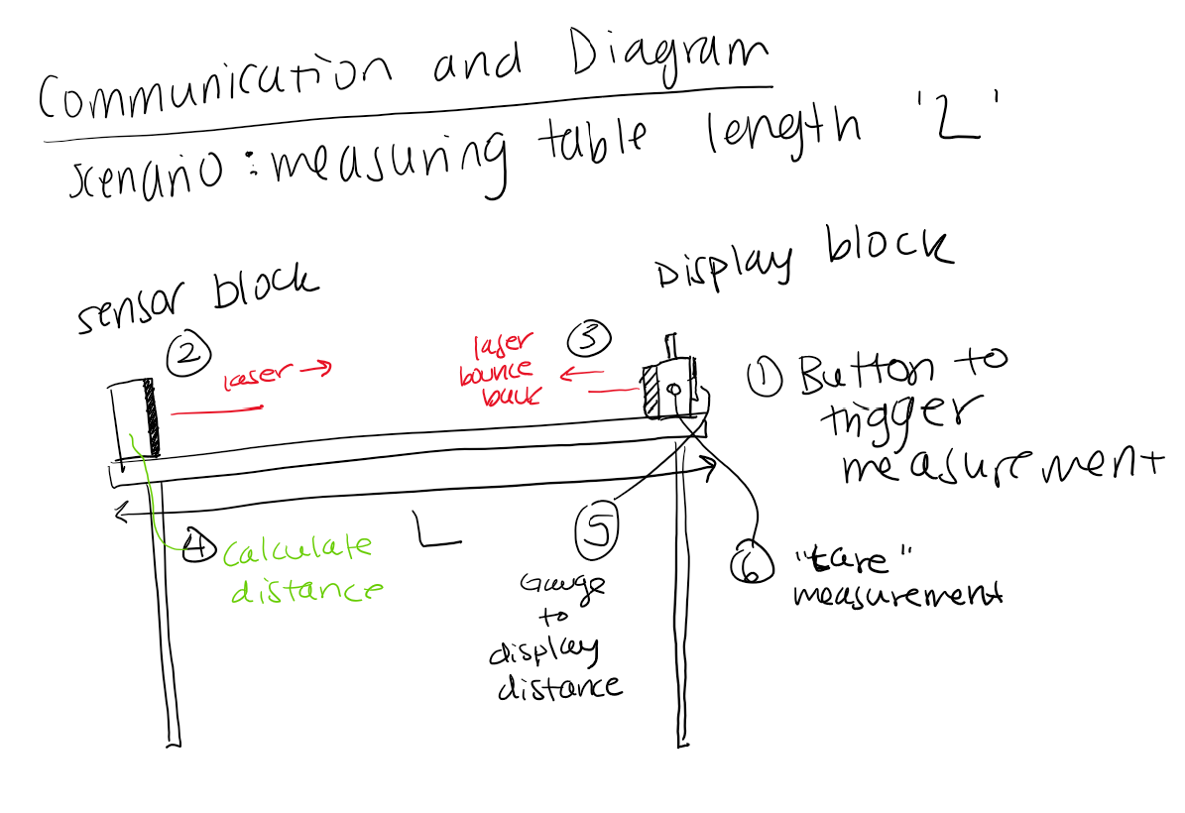
Measuring alone
A proposed Solution:
Wireless tape measurement
2-piece system to measure from point A to point B
Notes:
Insert picture once prints are done

Slide 4
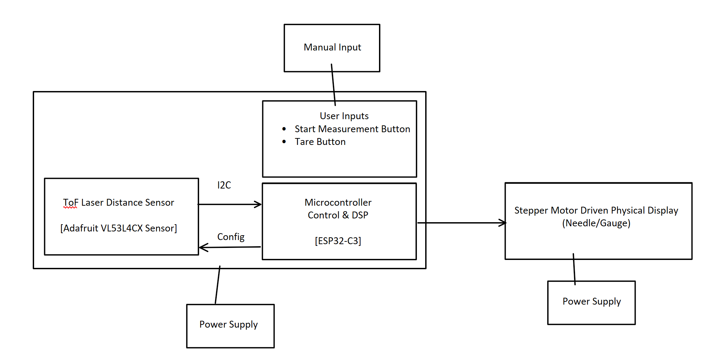
System Architecture

Slide 5
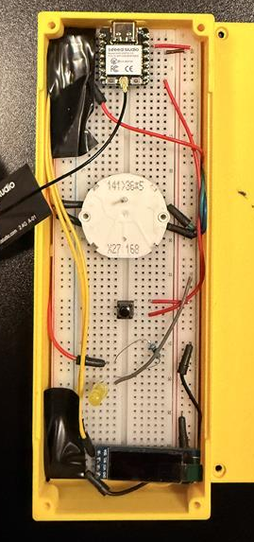
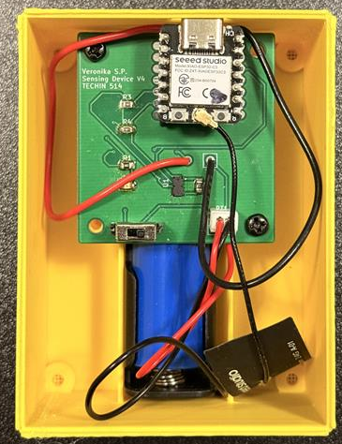
Sensing + Display Device
Due to multiple ESP32C3 Battery pad mishaps, this is not battery powered for cautionary measures
XIAO ESP32C3
Time of Flight Laser Sensor
X27 Stepper Motor
“Tare” Button
Power On/Off Switch
Sensor Device
OLED Display
Display Device
Notes:
Insert picture once prints are done

Slide 6
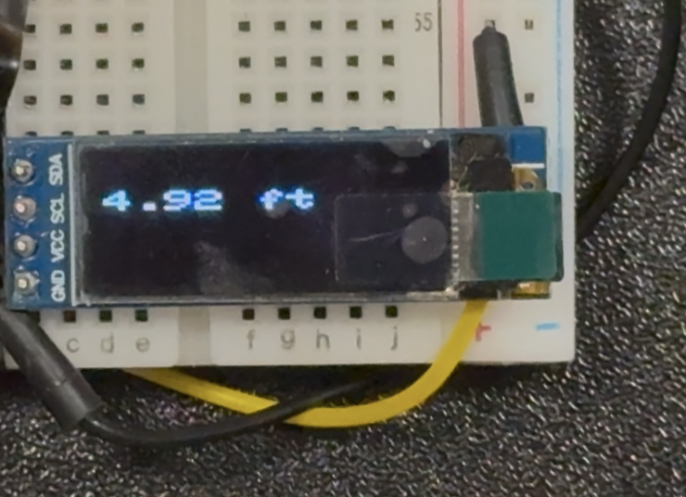
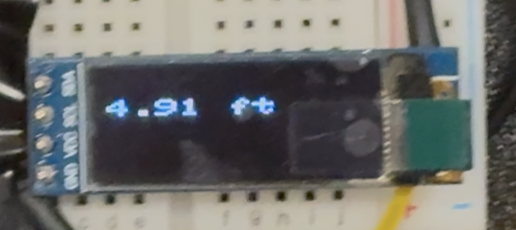
Signal Processing
Moving average filter, numbers were the same at the first decimal place before filter.
Accuracy:
±0.01 ft
±3mm
Degrades with distance
Display Device shows sensor jumping between measurements – from table to ceiling

Slide 7
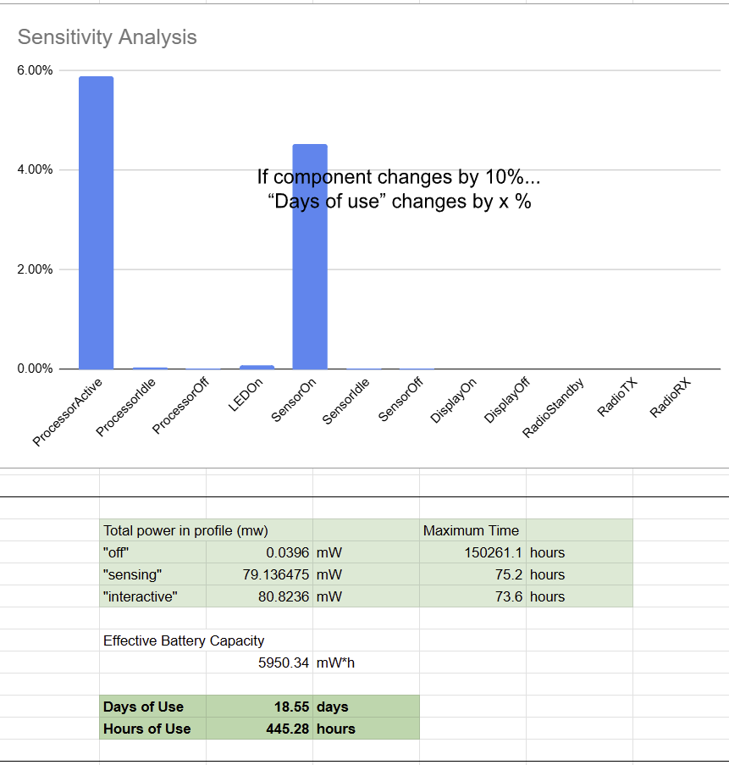
Battery Considerations – Sensing device
3.7V Lipo or Li-Ion Battery
Compact easy to design with in enclosure and long lasting
Based on 2hrs/day of use

Slide 8
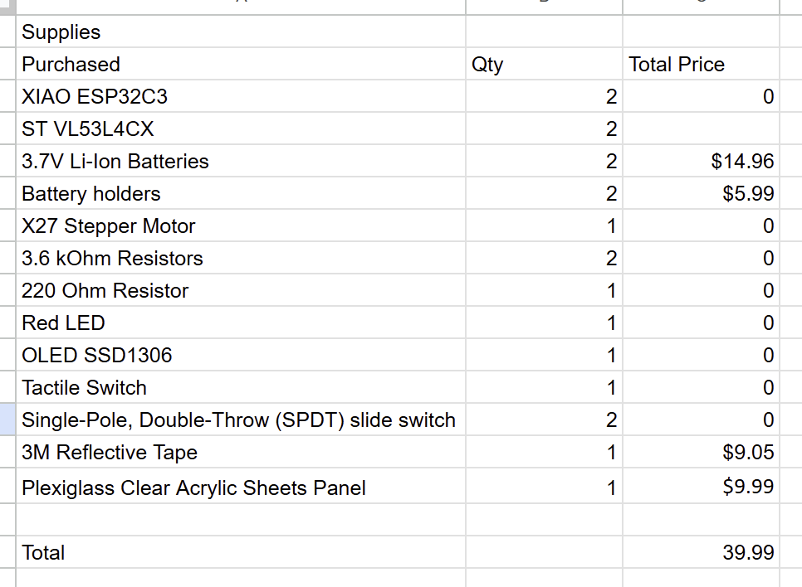
Appendix
Anything with “$0” was free in the Maker Space
Budget Summary

Slide 9
Future Work
Sensor Calibration to get rid of cross-talk from clear acrylic window.
Sensor Calibration to find max capable distance based on Bluetooth connection compatibility
Develop a more ergonomic and detachable/portable enclosure(s)
Proper PCB design for easy battery connection to Display device.

Slide 10
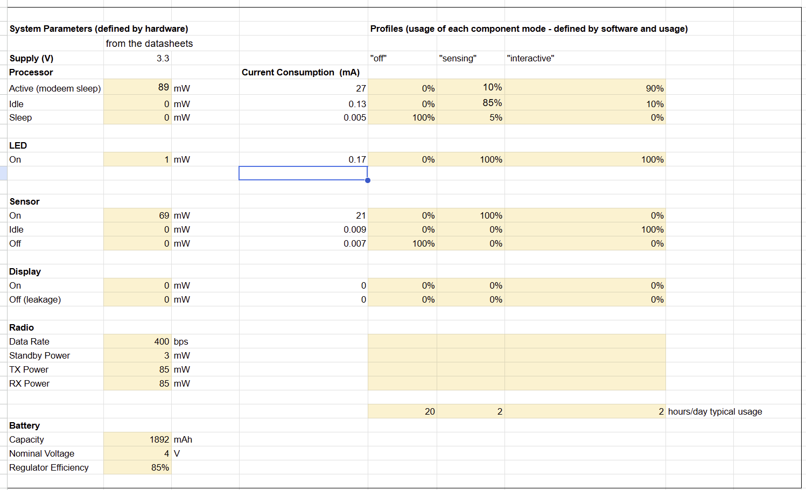
Appendix
Power Model (Sensing Device)

Slide 11
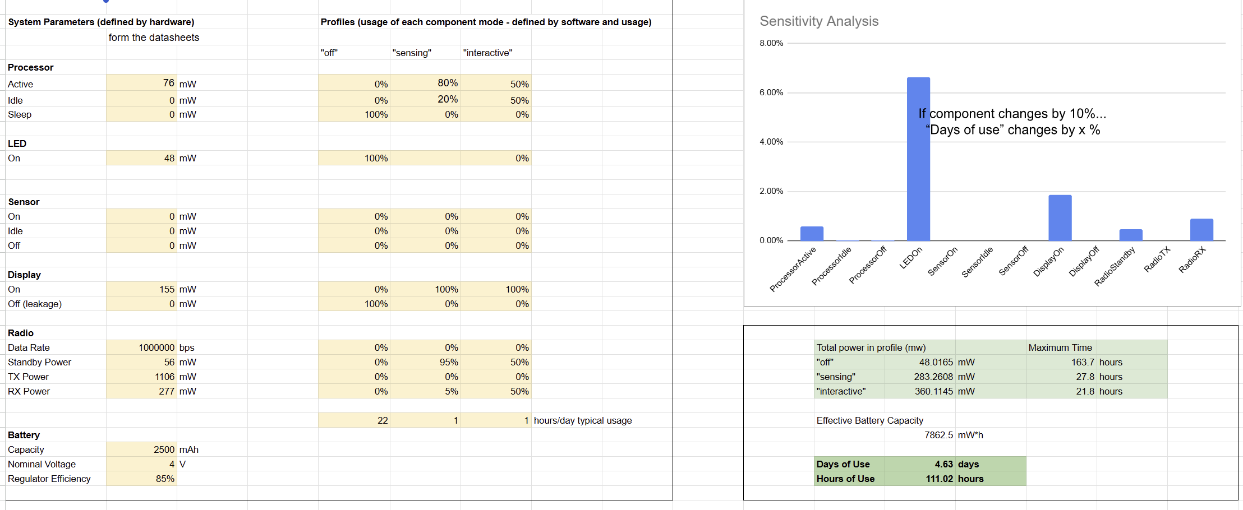
Appendix
Power Model (Display Device) if it were battery powered

Slide 12
Appendix
Anything with “$0” was free in the Maker Space
Budget Summary

Slide 13
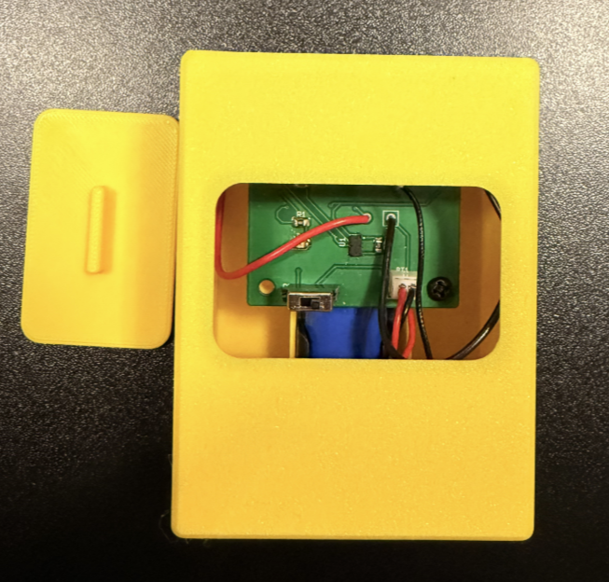
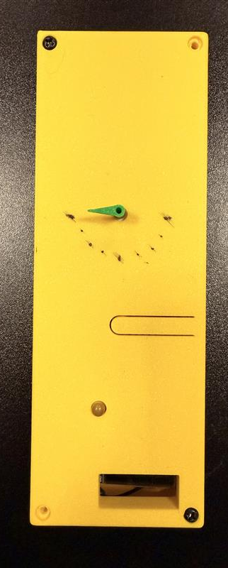
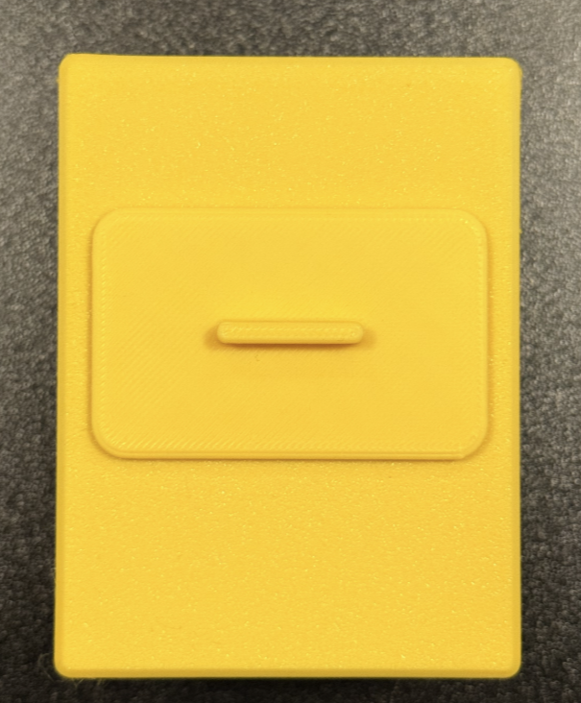
Appendix
Enclosure Design
Sensor Device
Display Device
Due to multiple ESP32C3 Battery pad mishaps, this is not battery powered for cautionary measures

